Slide 1

DEMOCRITUS UNIVERSITY OF THRACE
SCHOOL OF ENGINEERING
DEPARTMENT OF ELECTRICAL AND COMPUTER ENGINEERING
SECTOR OF ELECTRONICS AND INFORMATION TECHNOLOGY SYSTEMS
MASS DETECTION IN DIGITAL BREAST TOMOSYNTHESIS
IMAGES
Diploma Thesis
Bitzidis Charalampos
S.I.N.: 57424
Supervisor: Ioannis Pratikakis
Professor DUTh

Slide 2
Contents of Diploma Thesis Presentation
Breast Cancer problem
Digital Mammography (FFDM)
Breast Density
Digital Breast Tomosynthesis (DBT)
The YOLO network
Architecture
Predictions volume
Predictions dimensions
DenseNets architecture
Introduction
Network example
The DenseYOLO network

Slide 3
Contents of Diploma Thesis Presentation
The YOLOv5 network
Data Augmentation on DenseYOLO network
Data Augmentation on YOLOv5 network
Image Preprocessing on YOLOv5 network
Results of DenseYOLO network
Results of images from biopsy
Results of images from the whole dataset
Results comparison of images from biopsy and images from the whole dataset
Results of YOLOv5 network
Results of Digital Breast Tomosynthesis images
Results of Digital Mammography images
Results of Transfer Learning techniques
Indicative Bibliography

Slide 4
Breast Cancer problem
Statistical data:
most common type of cancer in the UK and second in the USA
almost 10% of women worldwide are likely to experience it
Major risk categories:
women over 50 years old
women with high breast density
Breast Cancer treatment:
preventive examinations
early diagnosis
Common Medical Imaging techniques:
ultrasound
breast MRI
mammography

Slide 5
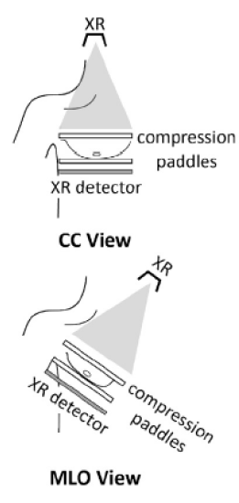
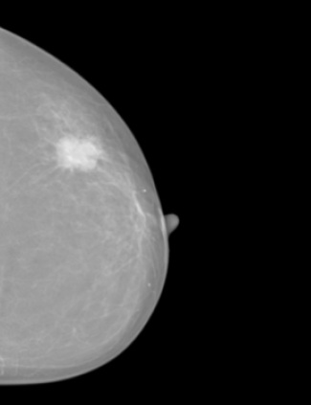
Digital Mammography (FFDM)
2D imaging technique
Replacement of analog mammography: Screen Film Mammography
Findings:
masses
microcalcifications
architectural distortions

Slide 6
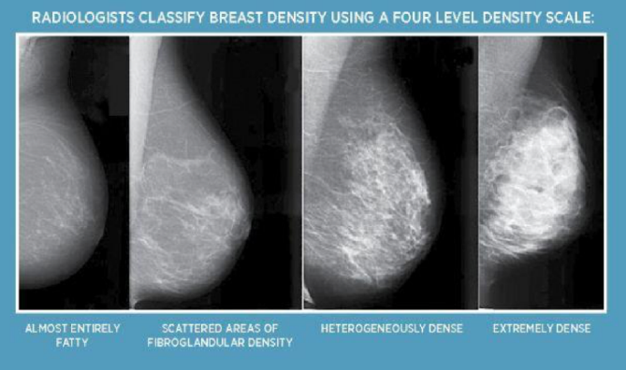
Breast Density

Slide 7
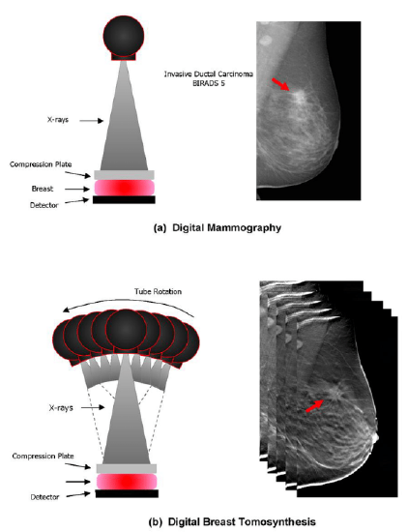
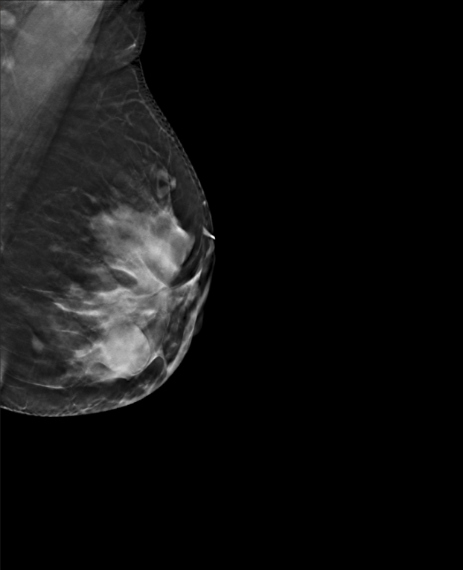
Digital Breast Tomosynthesis (DBT)
3D imaging technique
It is a series of 2D breast imaging slices
Findings:
masses
microcalcifications
architectural distortions
Great utility:
cases of dense breasts

Slide 8
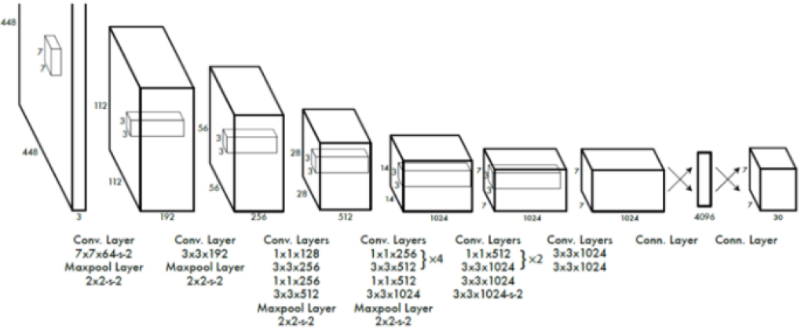
The YOLO network - Architecture
You Only Look Once!
Consists of:
24 convolutional layers
2 fully connected layers

Slide 9
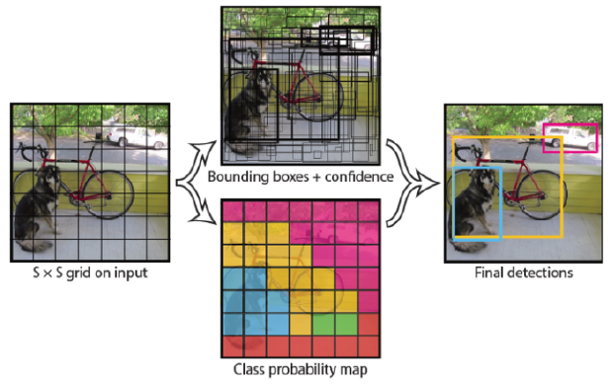
The YOLO network - Predictions volume
YOLO specifications:
S x S : cell grid
B : number of bounding boxes per cell
C : number of classes
Output:
S x S x (B * 5 + C)

Slide 10
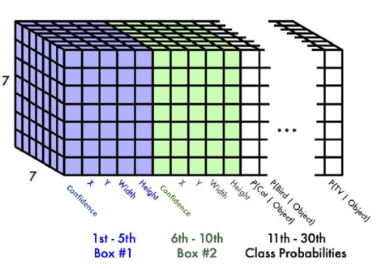
The YOLO network - Predictions dimensions
For example for the values:
S = 7
B = 2
C = 20
Output:
S x S x (B * 5 + C) = 7 x 7 x 30

Slide 11
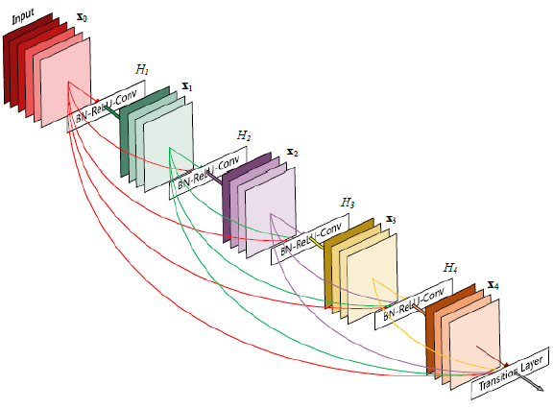
DenseNets architecture - Introduction
Advantages:
solving the "vanishing-gradient" problem in CNNs
reuse of feature maps
reduced parameter size
A traditional CNN has:
L layers
L connections between the layers
A DenseNet has:
L layers
L*(L+1)/2 connections between the layers

Slide 12
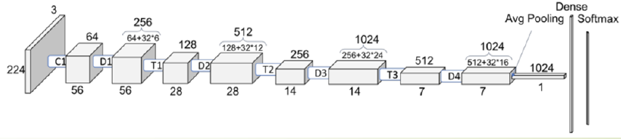
DenseNets architecture - Network example
Convolutional layers: C1
Dense blocks: {D1, D2, D3, D4} = {6, 12, 24, 32}
Transition layers: T1, T2, T3
Growth rate: 32

Slide 13
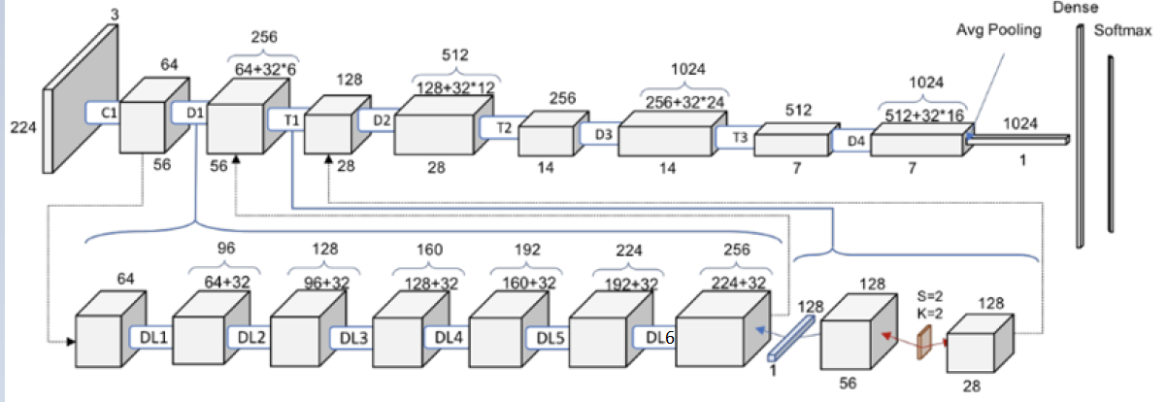
DenseNets architecture - Network example
Dense Block D1: 56x56x64 ➡ 56x56x256
Dense layers: {DL1, DL2, DL3, DL4, DL5, DL6}
Growth rate: 32
Transition layer T1 56x56x256 ➡ 28x28x128
Convolutional layer: 1x1x128
Pooling layer: 2x2

Slide 14
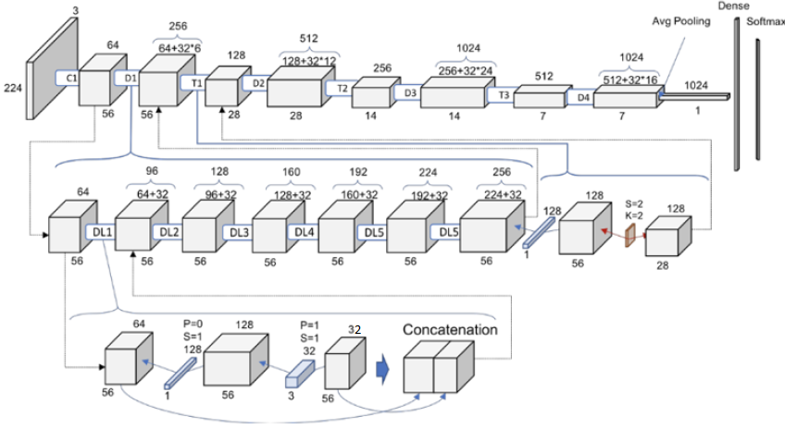
DenseNets architecture - Network example
Dense layer DL1: 56x56x64 ➡ 56x56x96
Convolutional layer 1x1x128
Convolutional layer 1x1x32
Concatenation of feature maps: 56x56x96

Slide 15
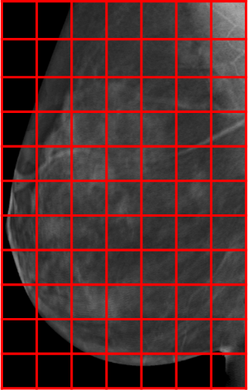
The DenseYOLO network
predictions dimensions 11x7x5:
confidence score
x offset
y offset
x scale
y scale
{D1, D2, D3, D4, D5} = {1, 3, 2, 6, 4}
YOLO specifications:
1 bounding box per cell
1 class
input image: 1056x672
cell size: 96x96

Slide 16
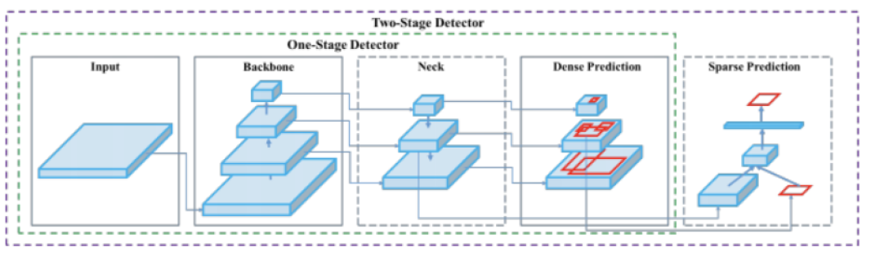
The YOLOv5 network
Backbone:
extracts features from input images
Neck:
combines the features
Head:
predictions creation (class, box coordinates)

Slide 17
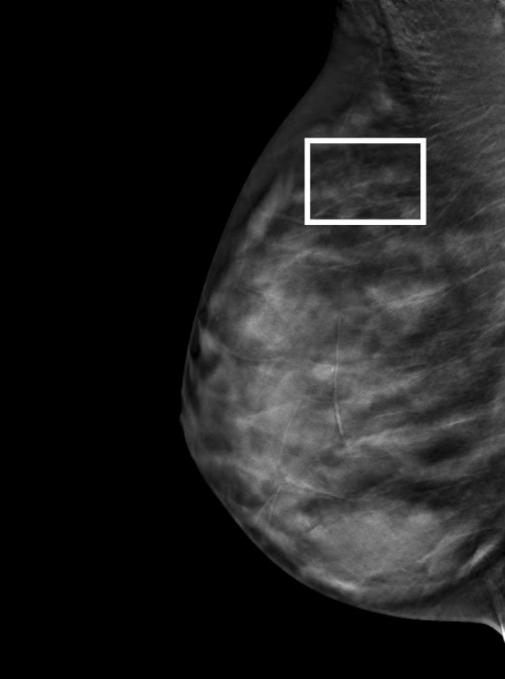
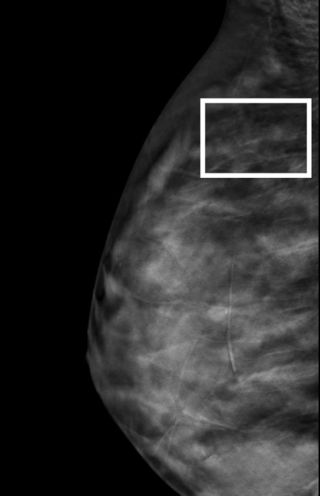
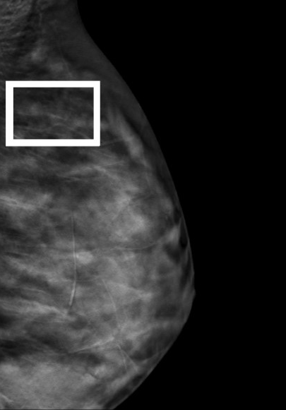
Data Augmentation on DenseYOLO network
random scaling
random cropping, so that the ground truth bounding box is included
random horizontal flipping
cropped image:
(1056, 672)
input image:
(1229, 945)
scaled image:
(1322, 1017)
flipped image:
(1056, 672)

Slide 18
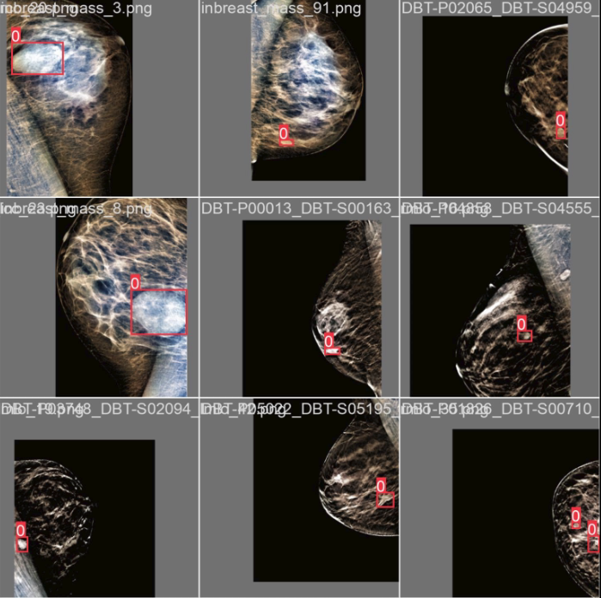
Data Augmentation on YOLOv5 network
random image translation
random horizontal and vertical flipping

Slide 19
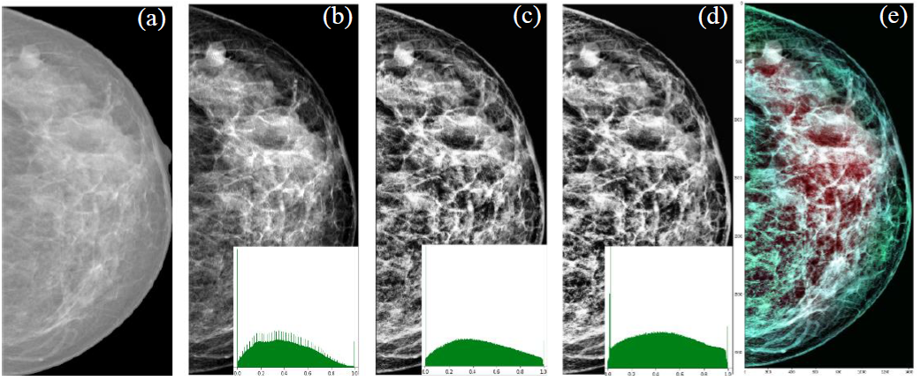
Image Preprocessing on YOLOv5 network
cropping of the images so that the breast is included
application of truncation normalization technique
application of Contrast Limited Adaptive Histogram Equalization (CLAHE) technique
image synthesis into the RGB format

Slide 20
Results of DenseYOLO network
Results of images from biopsy:
 | validation interval | schedule patience | factor | TPR2 validation | TPR2 test
experiment 1 | 5 | 10 | 0.5 | 0.66 | 0.7192
experiment 2 | 1 | 30 | 0.9 | 0.66 | 0.6666
experiment 3 | 1 | 50 | 0.5 | 0.624 | 0.6666
experiment 4 | 1 | 50 | 0.5 | 0.64 | 0.6596
experiment 5 | 5 | 10 | 0.1 | 0.638 | 0.6491
experiment 6 | 1 | 50 | 0.3 | 0.6511 | 0.6257
experiment 7 | 1 | 30 | 0.4 | 0.6 | 0.5964
experiment 8 | 5 | 10 | 0.3 | 0.58 | 0.5877
epochs: 20000
patience: 500
initial learning rate: 0.001

Slide 21
Results of DenseYOLO network
Results of images from the whole dataset:
 | validation interval | schedule patience | factor | TPR2 validation | TPR2 test
experiment 9 | 5 | 10 | 0.5 | 0.44 | 0.3684
experiment 10 | 1 | 30 | 0.9 | 0.66 | 0.5748
experiment 11 | 1 | 50 | 0.5 | 0.66 | 0.4584
experiment 12 | 1 | 50 | 0.5 | 0.6880 | 0.5748
experiment 13 | 5 | 10 | 0.1 | 0.62 | 0.6052
experiment 14 | 1 | 50 | 0.3 | 0.66 | 0.5789
experiment 15 | 1 | 30 | 0.4 | 0.7 | 0.5438
experiment 16 | 5 | 10 | 0.3 | 0.59 | 0.52
epochs: 20000
patience: 500
initial learning rate: 0.001

Slide 22
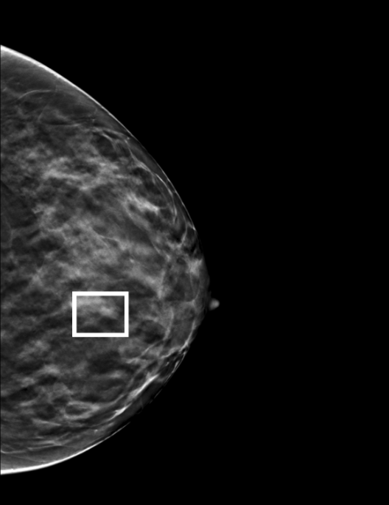
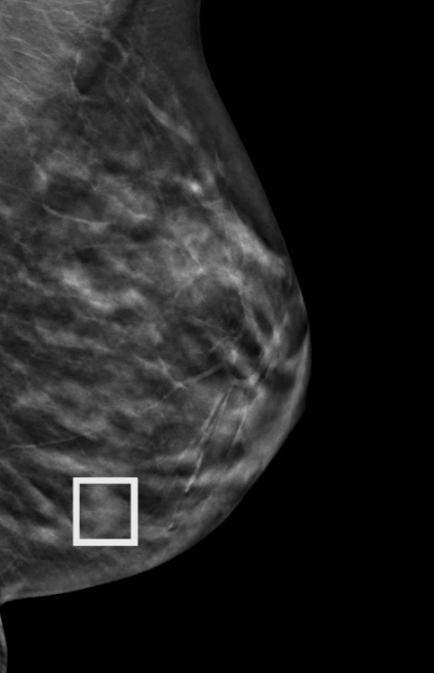
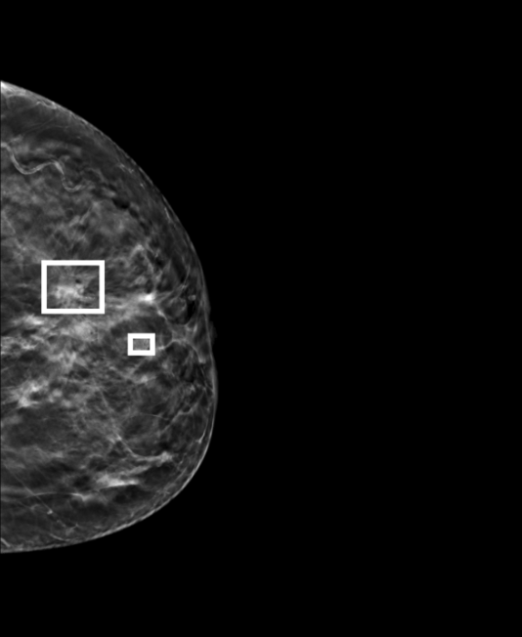
Results of DenseYOLO network
Results comparison of images from biopsy and images from the whole dataset:

Slide 23
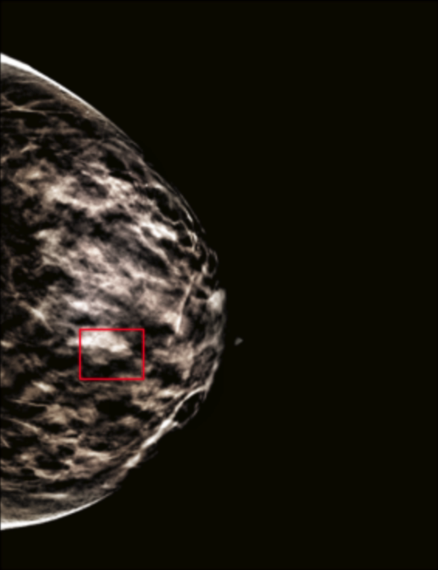
Results of YOLOv5 network
Results of Digital Breast Tomosynthesis images:
 | mAP50 validation | mAP50 test | mAP50-95 validation | mAP50-95 test
DBT PP | 0.414 | 0.372 | 0.191 | 0.141
DBT no PP | 0.434 | 0.441 | 0.176 | 0.188

Slide 24
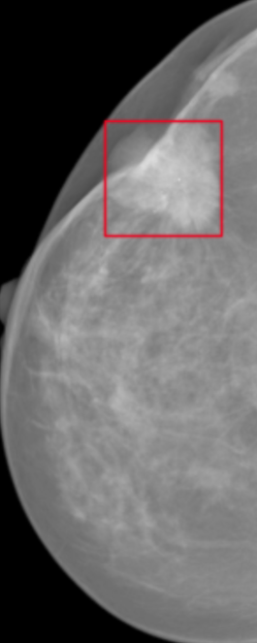
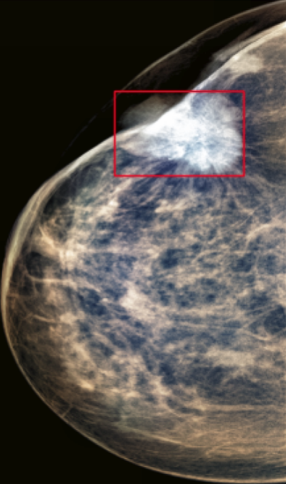
Results of YOLOv5 network
Results of Digital Mammography images:
 | mAP50 validation | mAP50 test | mAP50-95 validation | mAP50-95 test
INbreast PP | 0.824 | 0.763 | 0.507 | 0.443
INbreast no PP | 0.86 | 0.732 | 0.541 | 0.439

Slide 25
Results of YOLOv5 network
Results of Transfer Learning techniques:
images with preprocessing
 | mAP50 validation | mAP50 test | mAP50-95 validation | mAP50-95 test
DBT | 0.414 | 0.372 | 0.191 | 0.141
INbreast in train set | 0.429 | 0.266 | 0.177 | 0.108
pretrained on INbreast | 0.409 | 0.361 | 0.178 | 0.133

Slide 26
Results of YOLOv5 network
Results of Transfer Learning techniques:
images without preprocessing
 | mAP50 validation | mAP50 test | mAP50-95 validation | mAP50-95 test
DBT | 0.434 | 0.441 | 0.176 | 0.188
INbreast in train set | 0.458 | 0.395 | 0.204 | 0.185
pretrained on INbreast | 0.368 | 0.452 | 0.17 | 0.185

Slide 27
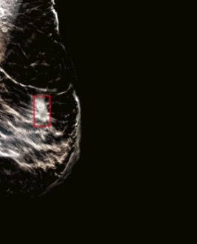
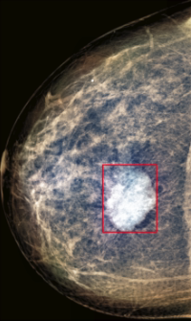
Results of YOLOv5 network
Results of Transfer Learning techniques:
images with preprocessing
DBT database image
INbreast database image

Slide 28
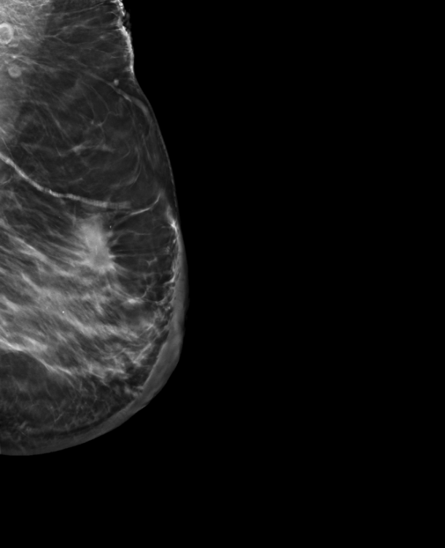
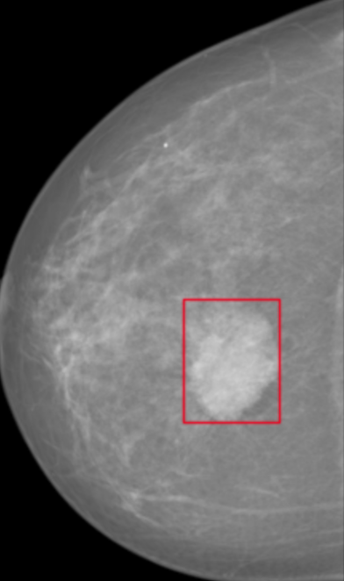
Results of YOLOv5 network
Results of Transfer Learning techniques:
images without preprocessing
DBT database image
INbreast database image

Slide 29
Indicative Bibliography
Buda, M. et al. (2021) “A data set and deep learning algorithm for the detection of masses and architectural distortions in digital breast tomosynthesis images,” JAMA Network Open, 4(8). Available at: https://doi.org/10.1001/jamanetworkopen.2021.19100.
Redmon, J. et al. (2016) “You only look once: Unified, real-time object detection,” 2016 IEEE Conference on Computer Vision and Pattern Recognition (CVPR) [Preprint]. Available at: https://doi.org/10.1109/cvpr.2016.91.
Huang, G. et al. (2017) “Densely connected Convolutional Networks,” 2017 IEEE Conference on Computer Vision and Pattern Recognition (CVPR) [Preprint]. Available at: https://doi.org/10.1109/cvpr.2017.243.
Cao, H. et al. (2021) “Breast mass detection in digital mammography based on Anchor-free architecture,” Computer Methods and Programs in Biomedicine, 205, p. 106033. Available at: https://doi.org/10.1016/j.cmpb.2021.106033.
Girshick, R. et al. (2014) “Rich feature hierarchies for accurate object detection and semantic segmentation,” 2014 IEEE Conference on Computer Vision and Pattern Recognition [Preprint]. Available at: https://doi.org/10.1109/cvpr.2014.81.

Slide 30


